Slide 1
Lecture – 16

Slide 2
A Multicycle Implementation
Each step in the execution will take one clock cycle.
It allows a functional unit to be used more than once per instruction, as long as it is used on different clock cycles.
Functional unit is shared between different clock cycles of an instruction.
This sharing can help reduce the amount of hardware required.

Slide 3
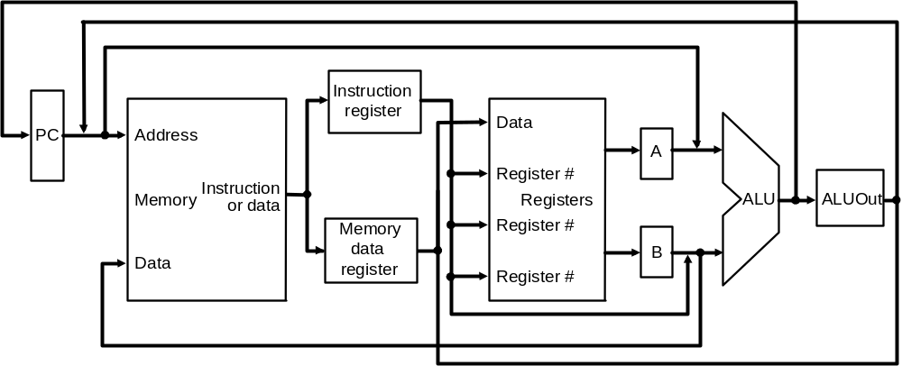
The High-level view of the Multicycle Datapath
A shared Memory Unit.
A single ALU.
Temporary registers to hold data between clock cycles of the same instruction. They are: Instruction register, Memory data register, A, B, and ALU Out.
Data to be used in later instructions are stored in programmer-visible state elements: the register file, PC, memory.
Data to be used in later clock cycles are stored in the additional registers.

Slide 4
Function of the Temporary Registers
IR and MDR are added to save the output of the memory for an instruction read and a data read, respectively. Two separate registers are used as both values are needed during the same clock cycle.
The A and B registers are used to hold the register operand values read from the register file.
The ALUOut register holds the output of the ALU.
All the registers except the IR hold data only between a pair of adjacent clock cycles.
The IR needs to hold the instruction until the end of execution of that instruction.

Slide 5
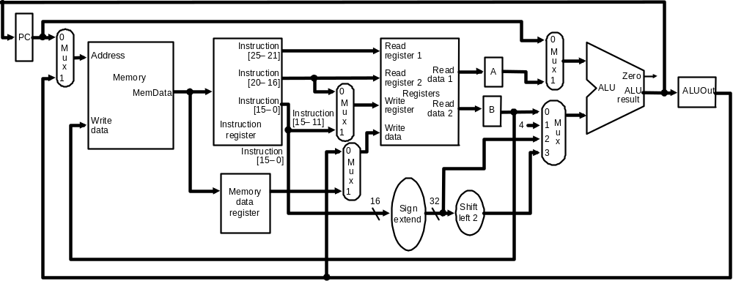
Multicycle Datapath
As several functional units are shared for different purposes, new multiplexors are added and existing multiplexors are expanded.

Slide 6
Additional Multiplexors
Replacing the three ALUs of the single-cycle datapath by a single ALU means that the single ALU must accommodate all the inputs that used to go to the three different ALUs. Handling the additional inputs requires two changes to the datapath:
1. An additional multiplexor is added for the first ALU input. The multiplexor chooses between the A register and the PC.
2. The multiplexor on the second ALU input is changed from a 2-way to 4-way multiplexor. The two additional inputs to the multiplexor are the constant 4 and the sign-extended and shifted offset field.

Slide 7
Breaking Instruction into Steps
Instruction | Description | Inside processor’s task
Add Sub | R[rd] <– R[rs] + R[rt]; PC <– PC + 4 CLK CYCLE :– 4 | 1. IR <– MEM[pc]; PC <– PC + 4 2. A<– R[rs]; B <– R[rt] 3. S <– A + B 4. R[rd] <– S;
Load | R[rt]<– MEM[R[rs]+SExt(Im16)]; PC <– PC + 4 CLK CYCLE :- 5 | 1. IR <– MEM[pc]; PC <– PC + 4 2. A<– R[rs]; 3. S <– A + SExt(Im16) 4. M <– MEM[S]; 5. R[rt] <– M;
Store | MEM[R[rs]+SExt(Im16)] <– R[rt]; PC <– PC + 4 CLK CYCLE :– 4 | 1. IR <– MEM[pc]; PC <– PC + 4 2. A<– R[rs]; B <– R[rt]; 3. S <– A + SExt(Im16); 4. MEM[S] <– B;
Branch | if R[rs] == R[rt] then PC <-PC + 4+SExt(Im16) || 00 else PC <= PC + 4 CLK CYCLE :- 3 | 1. IR <– MEM[pc]; PC <– PC + 4 3. E<– (R[rs] = R[rt]) if !E then do nothing 2. Else PC<-PC+SExt(Im16)||00

Slide 8
Step 1: Instruction Fetch & PC Increment (IF)
Use PC to get instruction and put it in the instruction register.
Increment the PC by 4 and put the result back in the PC.
IR = Memory[PC];
PC = PC + 4;

Slide 9
Step 2: Instruction Decode and Register Fetch (ID)
Read registers rs and rt in case we need them.
Compute the branch address.
A = Reg[IR[25-21]];
B = Reg[IR[20-16]];
ALUOut = PC + (sign-extend(IR[15-0]) << 2);

Slide 10
Step 3: Execution, Address Computation or Branch Completion (EX)
ALU performs one of four functions depending on instruction type
  memory reference:
  ALUOut = A + sign-extend(IR[15-0]);
  R-type:
  ALUOut = A op B;
  branch (instruction completes):
  if (A==B) PC = ALUOut;
  jump (instruction completes):
  PC = PC[31-28] || (IR(25-0) << 2)

Slide 11
Step 4: Memory access or R-type Instruction Completion (MEM)
Again depending on instruction type:
Loads and stores access memory
  load
  MDR = Memory[ALUOut];
  store (instruction completes)
  Memory[ALUOut] = B;
R-type (instructions completes)
Reg[IR[15-11]] = ALUOut;

Slide 12
Step 5: Memory Read Completion (WB)
Again depending on instruction type:
Load writes back (instruction completes)
Reg[IR[20-16]]= MDR;

Slide 13
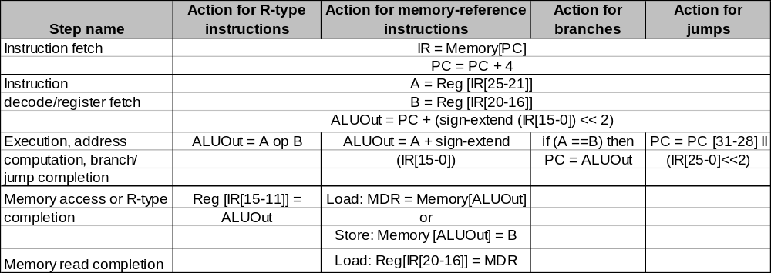
Summary of Instruction Execution
Step
1: IF
2: ID
3: EX
4: MEM
5: WB

Slide 14
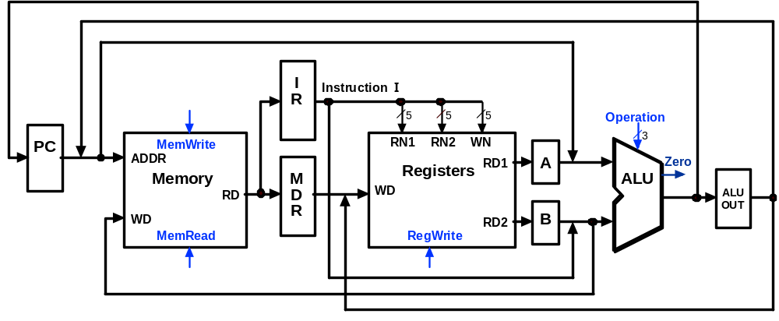
Multicycle Execution Step (1):
Instruction Fetch
IR = Memory[PC];
PC = PC + 4;
4
PC + 4

Slide 15
Multicycle Execution Step (2):
Instruction Decode & Register Fetch
A = Reg[IR[25-21]]; (A = Reg[rs])
B = Reg[IR[20-15]]; (B = Reg[rt])
ALUOut = (PC + sign-extend(IR[15-0]) << 2)
Reg[rs]
Branch
Target
Address
PC + 4
Reg[rt]

Slide 16
Multicycle Execution Step (3):
Memory Reference Instructions
ALUOut = A + sign-extend(IR[15-0]);
Reg[rs]
Mem.
Address
PC + 4
Reg[rt]

Slide 17
Multicycle Execution Step (3):
ALU Instruction (R-Type)
ALUOut = A op B
Reg[rs]
R-Type
Result
PC + 4
Reg[rt]

Slide 18
Multicycle Execution Step (3):
Branch Instructions
if (A == B) PC = ALUOut;
Reg[rs]
Branch
Target
Address
Branch
Target
Address
Reg[rt]

Slide 19
Multicycle Execution Step (3):
Jump Instruction
PC = PC[31-28] concat (IR[25-0] << 2)
Reg[rs]
Branch
Target
Address
Jump
Address
Reg[rt]

Slide 20
Multicycle Execution Step (4):
Memory Access - Read (lw)
MDR = Memory[ALUOut];
Reg[rs]
Mem.
Address
PC + 4
Mem.
Data
Reg[rt]

Slide 21
Multicycle Execution Step (4):
Memory Access - Write (sw)
Memory[ALUOut] = B;
Reg[rs]
PC + 4
Reg[rt]

Slide 22
Multicycle Execution Step (4):
ALU Instruction (R-Type)
Reg[IR[15:11]] = ALUOUT
Reg[rs]
R-Type
Result
PC + 4
Reg[rt]

Slide 23
Multicycle Execution Step (5):
Memory Read Completion (lw)
Reg[IR[20-16]] = MDR;
Reg[rs]
Mem.
Address
PC + 4
Mem.
Data
Reg[rt]

Slide 24
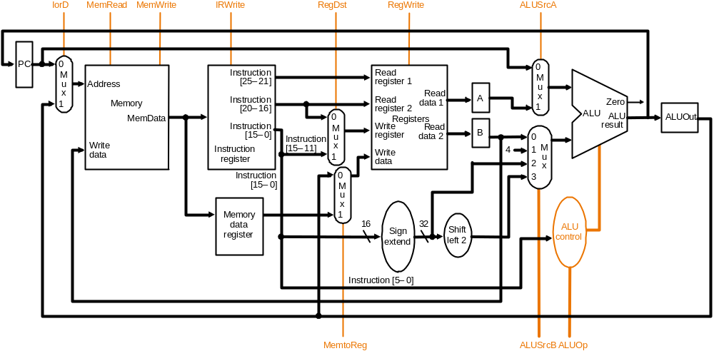
Multicycle Datapath with Control I
… with control lines and the ALU control block added – not all control lines are shown

Slide 25
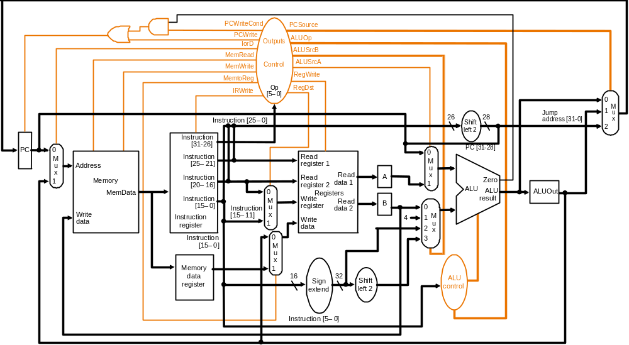
Multicycle Datapath with Control II
New gates
For the jump address
New multiplexor
Complete multicycle MIPS datapath (with branch and jump capability)
and showing the main control block and all control lines

Slide 26
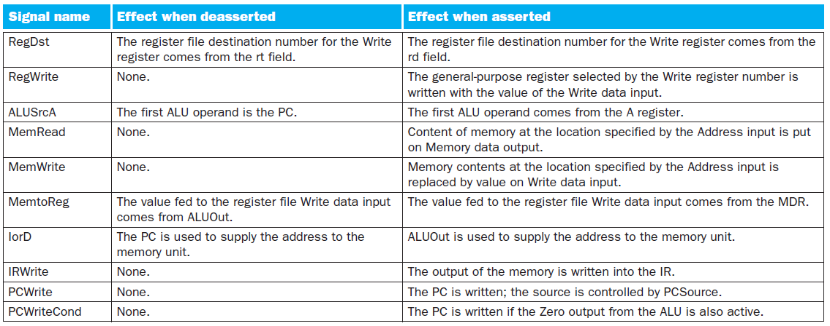

The actions caused by the setting of each control line

Slide 27
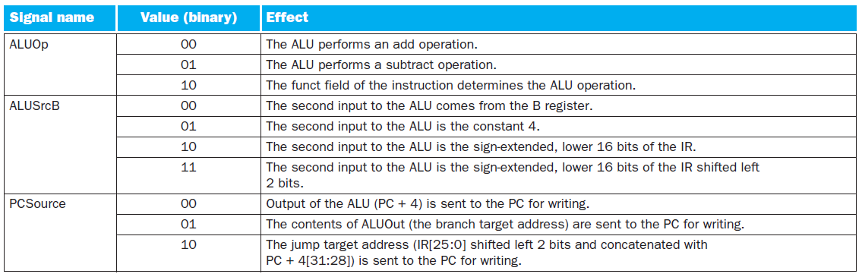
The actions caused by the setting of each control line

Slide 28
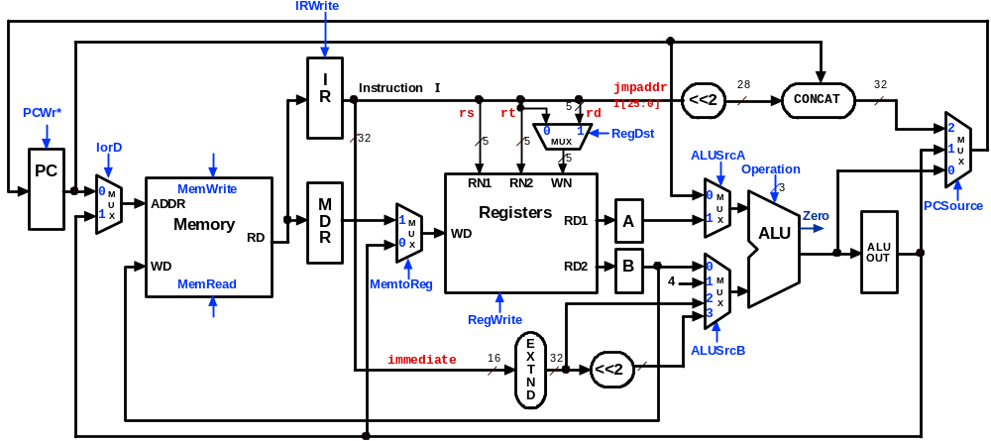
Multicycle Control Step (1):
Fetch
IR = Memory[PC];
PC = PC + 4;
1
1
0
0
0
X
00
00
X
1
0
01

Slide 29
Multicycle Control Step (2):
Instruction Decode & Register Fetch
A = Reg[IR[25-21]]; (A = Reg[rs])
B = Reg[IR[20-15]]; (B = Reg[rt])
ALUOut = (PC + sign-extend(IR[15-0]) << 2);
0
0
X
0
0
X
00
XX
X
0
0
11

Slide 30
Multicycle Control Step (3):
Memory Reference Instructions
ALUOut = A + sign-extend(IR[15-0]);
0
0
X
1
0
X
00
XX
X
0
0
10

Slide 31
Multicycle Control Step (3):
ALU Instruction (R-Type)
ALUOut = A op B;
0
0
X
1
0
X
10
XX
X
0
0
00

Slide 32
Multicycle Control Step (3):
Branch Instructions
if (A == B) PC = ALUOut;
0
1 if
Zero=1
X
1
0
X
01
01
X
0
0
00

Slide 33
Multicycle Execution Step (3):
Jump Instruction
PC = PC[21-28] concat (IR[25-0] << 2);
0
1
X
X
0
X
XX
10
X
0
0
XX

Slide 34
Multicycle Control Step (4):
Memory Access - Read (lw)
MDR = Memory[ALUOut];
0
0
1
X
0
X
XX
XX
X
1
0
XX

Slide 35
Multicycle Execution Steps (4)
Memory Access - Write (sw)
Memory[ALUOut] = B;
0
0
1
X
1
X
XX
XX
X
0
0
XX

Slide 36
Multicycle Control Step (4):
ALU Instruction (R-Type)
Reg[IR[15:11]] = ALUOut; (Reg[Rd] = ALUOut)
0
IRWrite
0
I
Instruction
I
jmpaddr
28
32
R
5
I[25:0]
<<2
CONCAT
PCWr*
X
rs
rt
rd
0
32
5
5
0
MUX
1
RegDst
X
2
M
IorD
5
1
ALUSrcA
XX
1
U
PC
Operation
0
X
0
M
MemWrite
RN1
RN2
WN
0
3
U
ADDR
M
Registers
M
PCSource
1
X
D
1
A
1
U
Zero
XX
Memory
0
M
WD
RD1
X
ALU
RD
R
0
U
1
X
ALU
WD
RD2
B
0
OUT
MemRead
MemtoReg
4
1
M
0
2
U
RegWrite
3
X
0
1
E
ALUSrcB
immediate
16
X
32
<<2
XX
T
N
D

Slide 37
Multicycle Execution Steps (5):
Memory Read Completion (lw)
Reg[IR[20-16]] = MDR;
IRWrite
0
0
I
Instruction
I
jmpaddr
28
32
R
5
I[25:0]
<<2
CONCAT
PCWr*
X
rs
rt
rd
X
0
32
0
1
RegDst
2
IorD
5
5
MUX
0
XX
1
M
5
ALUSrcA
U
PC
Operation
0
X
0
M
MemWrite
RN1
RN2
WN
0
3
U
ADDR
M
Registers
M
PCSource
1
X
D
1
RD1
A
1
U
Zero
XX
Memory
M
WD
X
ALU
RD
R
0
U
X
ALU
WD
RD2
B
0
OUT
MemRead
MemtoReg
4
1
M
1
2
U
0
RegWrite
3
X
1
E
ALUSrcB
immediate
16
X
32
<<2
XX
T
N
D

